Slide 1
Languages

Slide 2
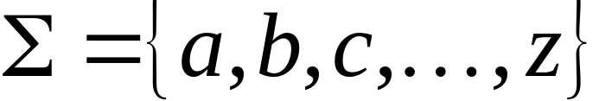
A language is a set of strings
String: A sequence of letters
  Examples: “cat”, “dog”, “house”, …
  Defined over an alphabet:

Slide 3

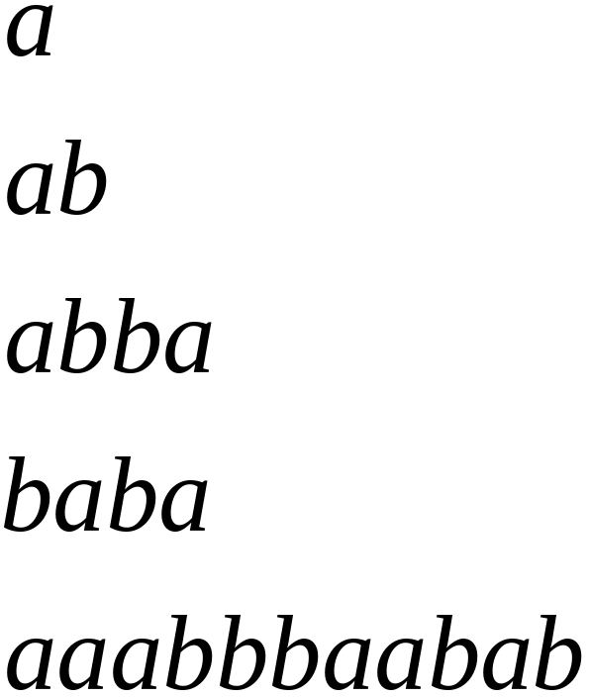
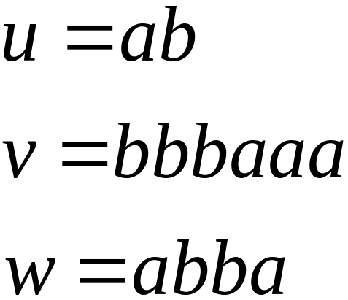
Alphabets and Strings
We will use small alphabets:
Strings

Slide 4
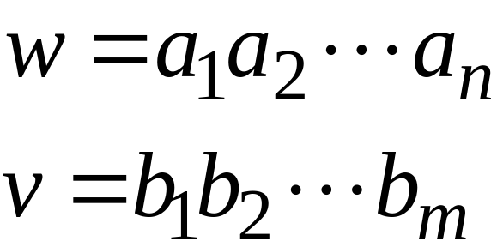
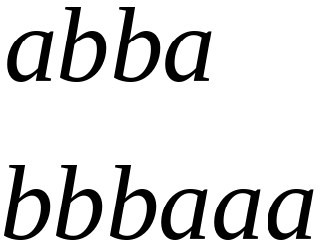
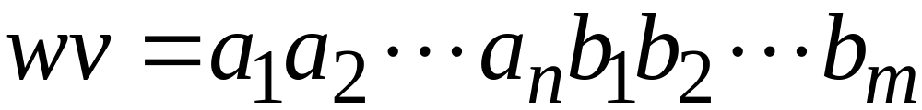

String Operations
Concatenation

Slide 5




Reverse

Slide 6


String Length
Length:
Examples:

Slide 7


Length of Concatenation
Example:

Slide 8

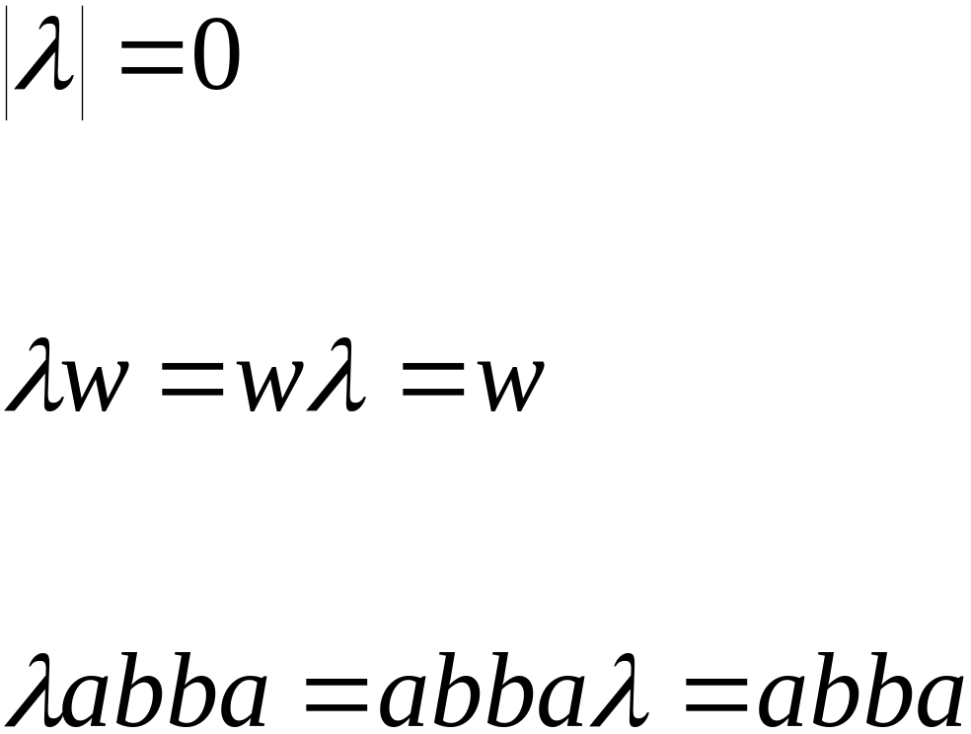
Empty String
A string with no letters:
Observations:

Slide 9


Substring
Substring of string:
  a subsequence of consecutive characters
String Substring

Slide 10




Prefix and Suffix
Prefixes Suffixes
prefix
suffix

Slide 11




Another Operation
Example:
Definition:

Slide 12



The * Operation
: the set of all possible strings from
alphabet

Slide 13

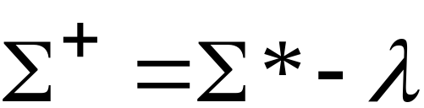
The + Operation
: the set of all possible strings from
alphabet except

Slide 14


Languages
A language is any subset of
Example:
Languages:

Slide 15




Note that:
Sets
Set size
Set size
String length

Slide 16




Another Example
An infinite language

Slide 17


Operations on Languages
The usual set operations
Complement:

Slide 18



Reverse
Definition:
Examples:

Slide 19


Concatenation
Definition:
Example:

Slide 20



Another Operation
Definition:
Special case:

Slide 21



More Examples

Slide 22


Star-Closure (Kleene *)
Definition:
Example:

Slide 23
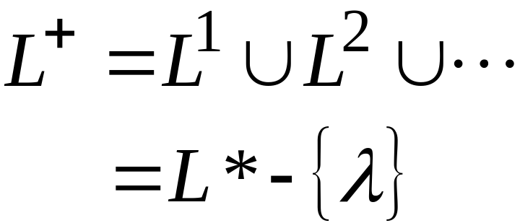

Positive Closure
Definition:

Slide 24
Exercise
Use induction on n to show that |u^{n}| = n |u| for all strings u and all n.
Let Σ = {a, b} and L = {aa, bb}. Use set notation to describe L.
Given Σ = {a, b} and L = {a^{n}b^{n} : n>=0}, check if the strings aabb, aaaabbbb, abb are in the language L.

Slide 25
Exercise
4. Let L = {ab, aa, baa}. Which of the following strings are in L*.
(a) abaabaaabaa
(b) aaaabaaaa
(c) baaaaabaaaab
(d) baaaaabaa

